Slide 1


Slide 2
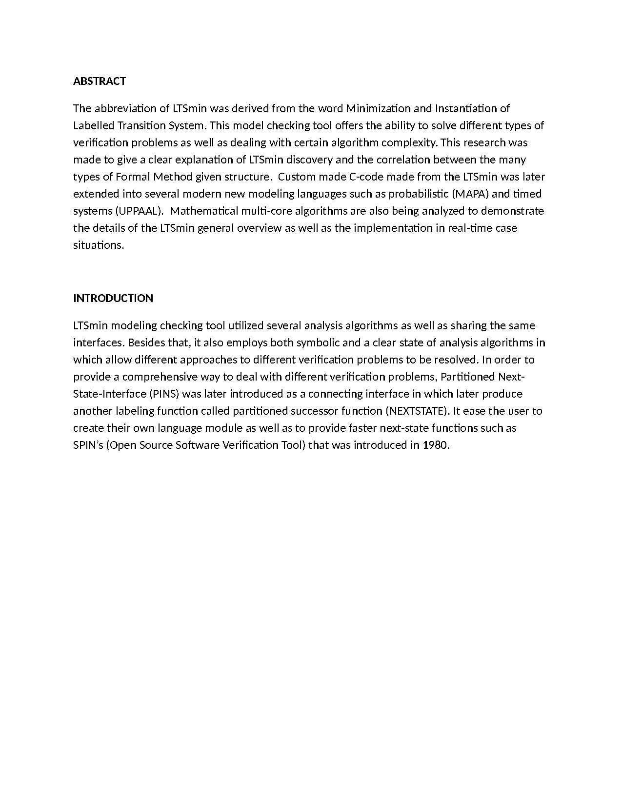
Introduction

Slide 3
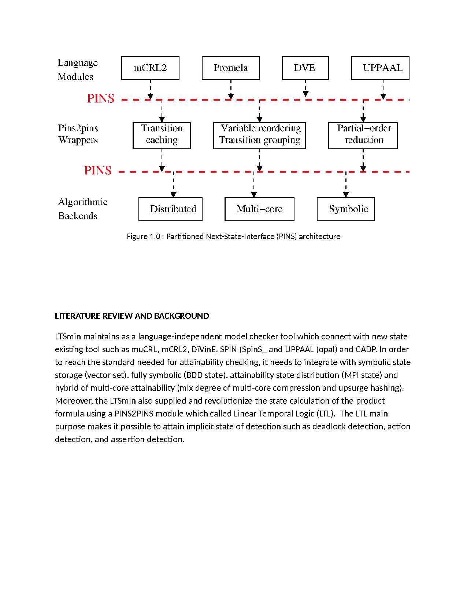

Slide 4
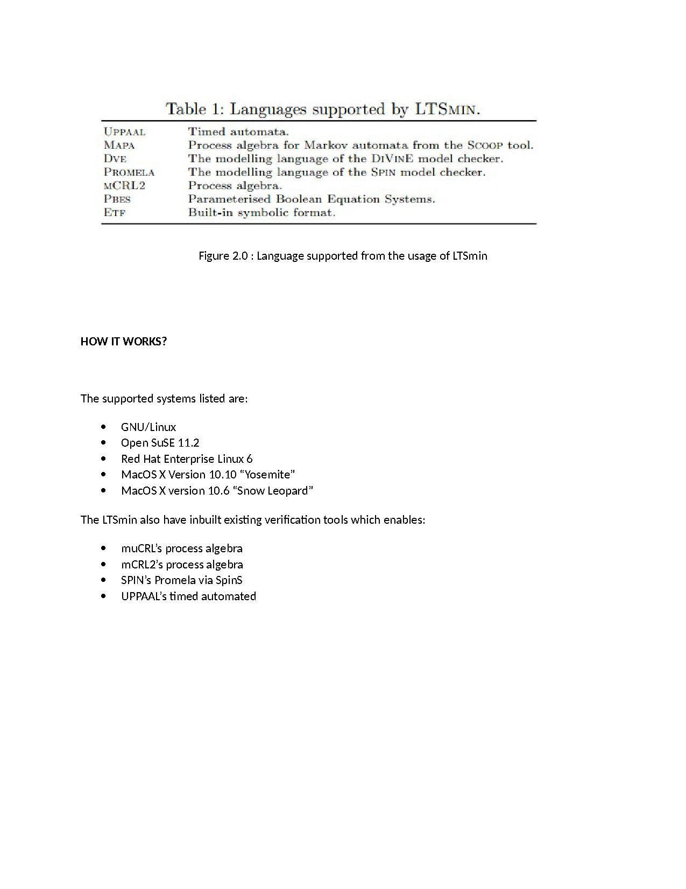

Slide 5
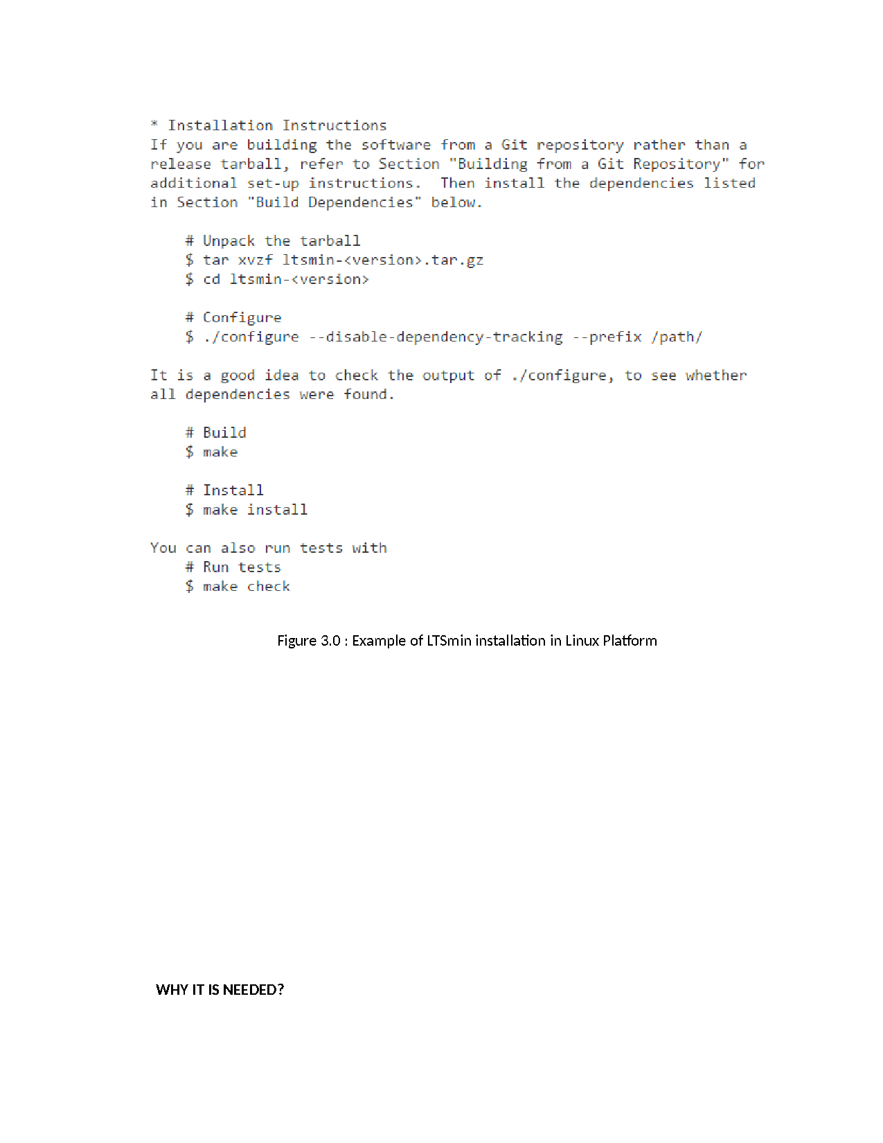

Slide 6
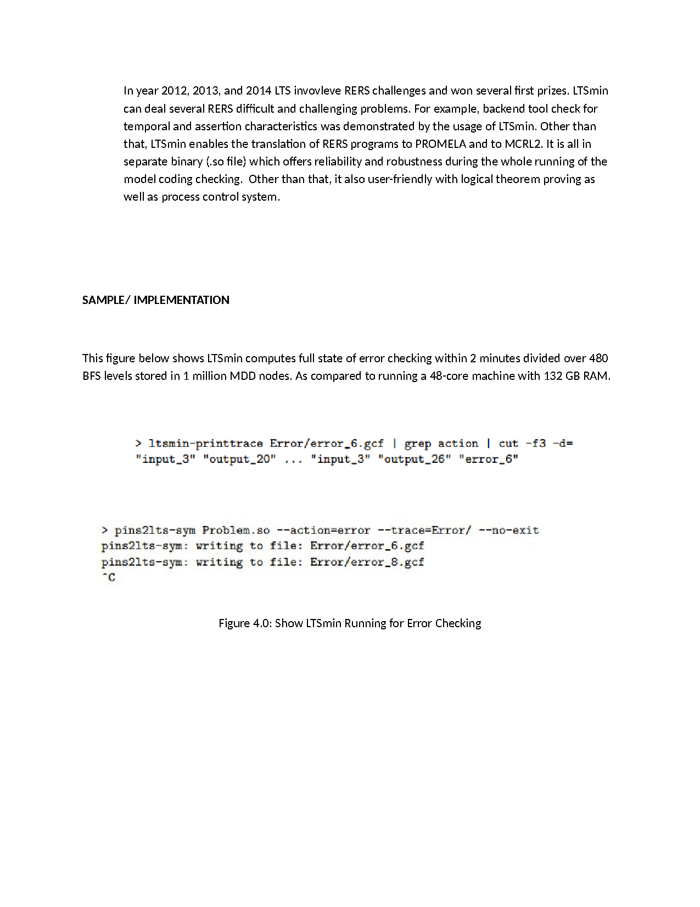
CRISIS ISSUE RESOLVE – YEAR 2012, 2013, 2014

Slide 7
